Slide 1
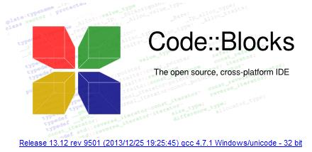
Project Title: Student Management System.
Course Code : CSE-107
Course Title : Object Oriented Programming.

Slide 2
Presenting By:
Md. Jahidur Rahman
ID: 2014-1-60-055
Md. Rifat Ullah
ID: 2014-1-60-102

Slide 3
Case Study :
This project is developed in code blocks :: IDE.
This project is developed in console mode.
It’s very easy to use for the user.
User can use this system after registration only.
Nobody can’t access others account without user name and password.
This project will maintain secure log in system.
It will provide some new ideas of Student management system.

Slide 4
Diagram:
Create New Account
Student Course
Student Details
Edit Details
Log In
CGPA Calculator
Course Chart
Help
Log Out
Exit

Slide 5
Details Of Our Project :
Student_Info class is used to store all information in registration.txt file.
Registration() function will input all the information from the user.
Login class is store all the function login related.
Login() function take user name and password from user and then this function will call profile function after successfully login with correct user name and password.
Show_Details() function will be shown all information to the user who log in already.

Slide 6
Details Of Our Project :
Edit function can help the user for edit his/her information.
Others class is control all the functions, which help user in many way.
Help() function help the user to take help from their advisor or faculty member department wise.
CGPA() function can help the user to calculate their CGPA easily.
Chart() function help student to know their Course Flow Chart department wise.

Slide 7
Details Of Our Project :
Main class store the Main_Menu() and Time() function.
Main_Menu() function help to show the Main Menu and Time() function show the time and date in the Main function.

Slide 8
Class Diagram:
class Student_Info
class login
class Others
class Main

Slide 9
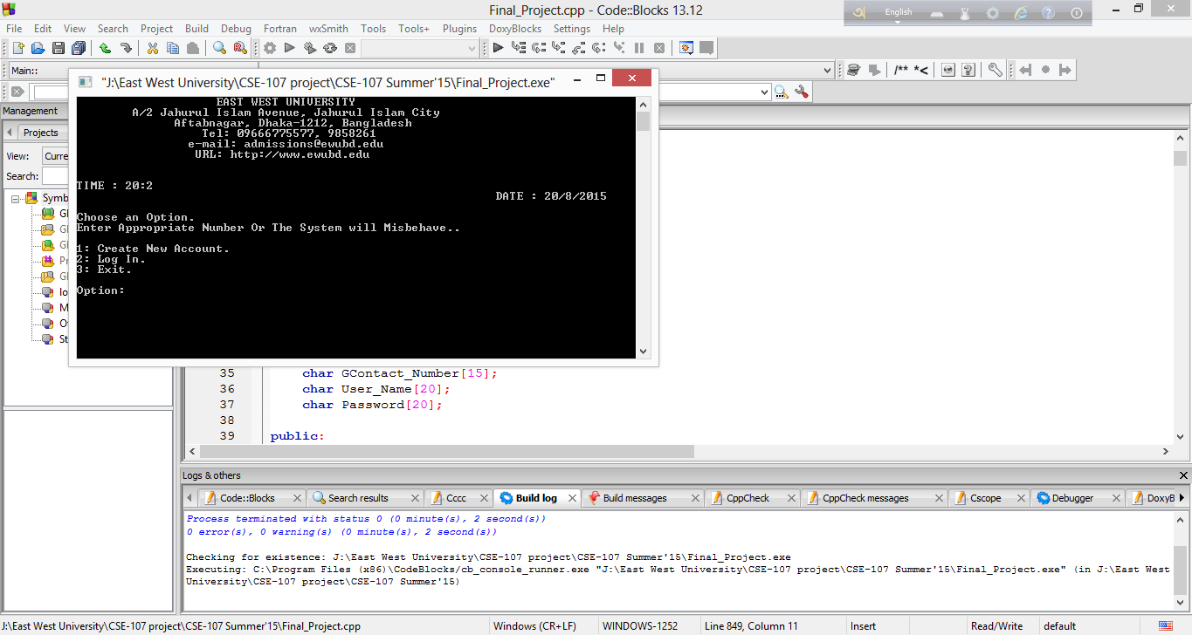
THANK YOU

